Slide 1
What we wanted to do
Insights
Improvement vs. Deterioration
Hotspots & Patterns
Further Analysis

Slide 2
How to improve GFP's tolerance towards mutations
Data analysis group project 2023
A presentation by Roman Kurley, Angela Ma, Lisa Duttenhöfer, Rebecca Ress

Slide 3
Our dataset
51.714 mutations
1083 single mutations
GFP DATASET SARKISYAN
PyRosetta
Amino acid porperties

Slide 4
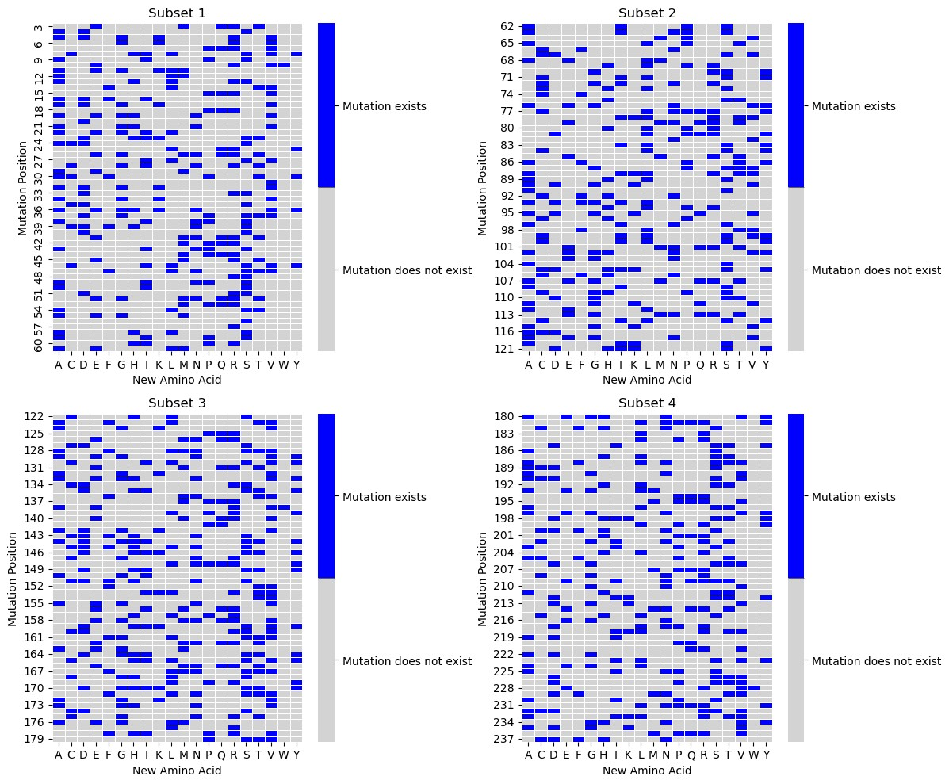
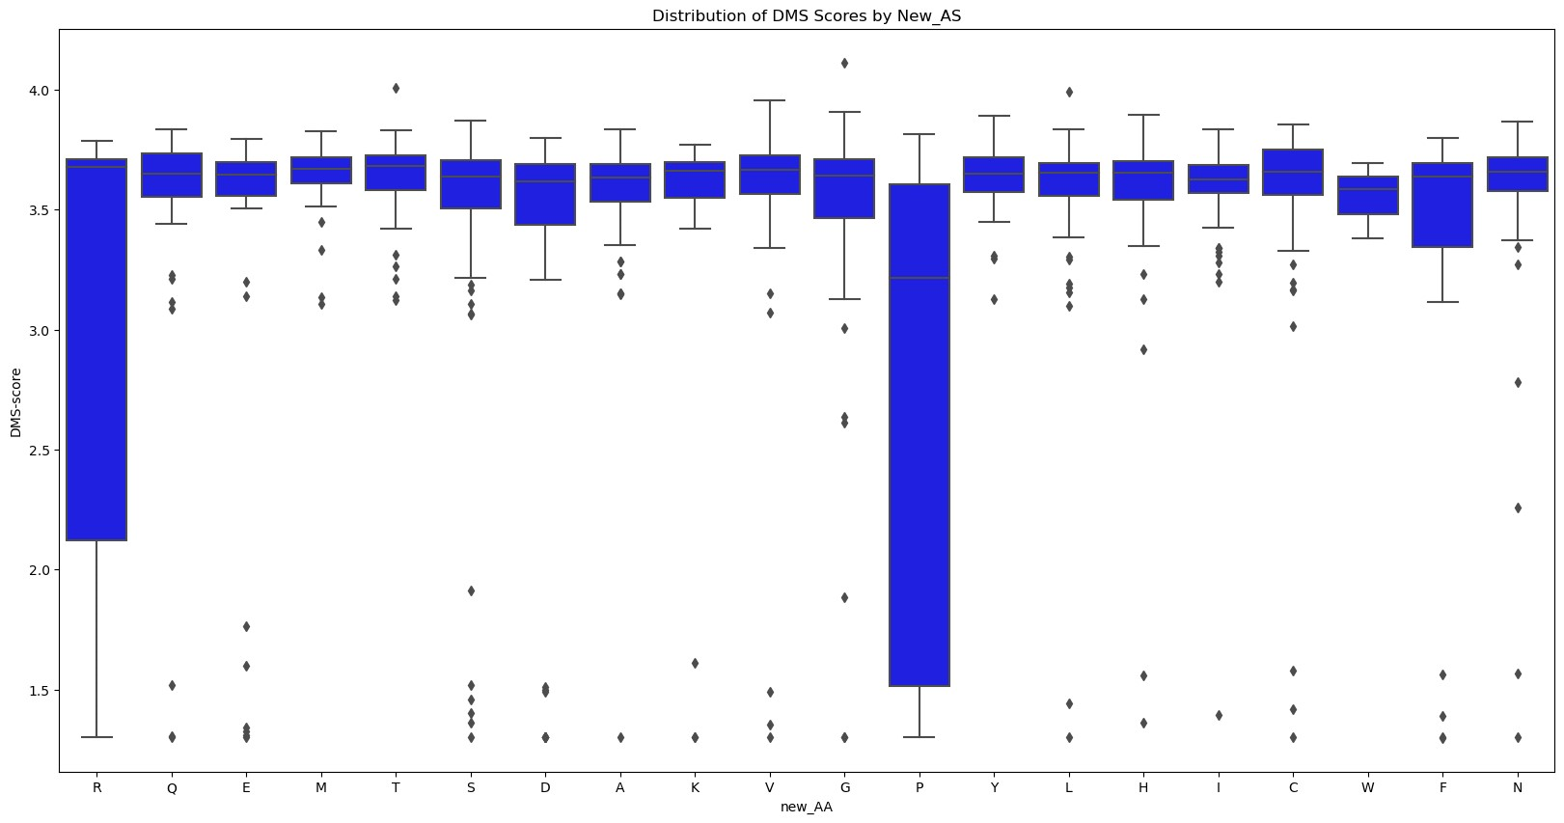
Does the position or new amino acid have a bigger influence on dms-scores?
Limited data available for single mutants

Slide 5
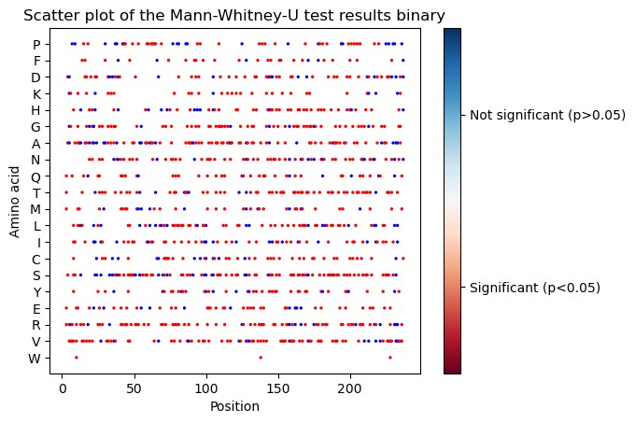
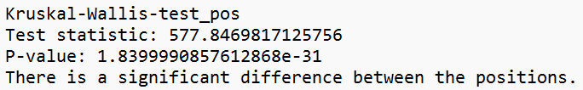
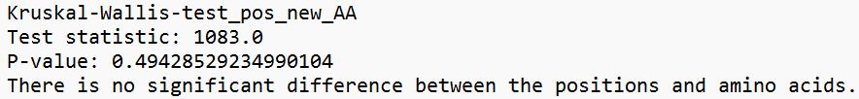
Does the position or new amino acid have a bigger influence on dms-scores?

Slide 6
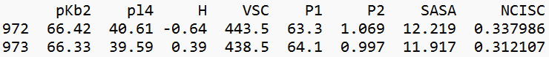
Amino acid properties
Unmutated sequence:
Neighbourhood

Slide 7
Sequential Mutants

Slide 8
Epistasis
mutations can have different effects on their own than when they occur together
masking effect
in our case: interaction of amino acid residues within the protein

Slide 9
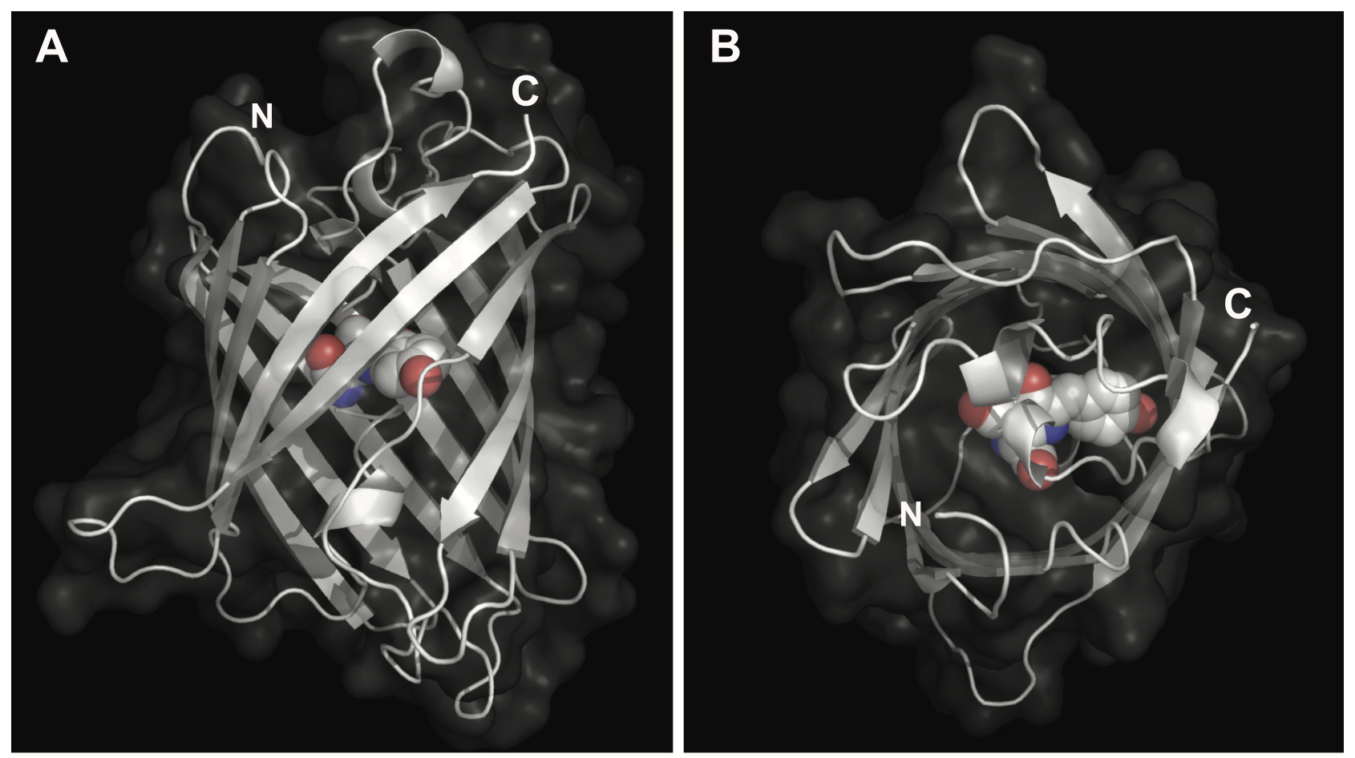
Structural Analysis
→ epistatic effects are stronger for buried amino acid residues
Chudakov, Dmitriy M et al. “Fluorescent proteins and their applications in imaging living cells and tissues.” Physiological reviews vol. 90,3 (2010): 1103-63. doi:10.1152/physrev.00038.2009

Slide 10
Analysis of stabilzing mutations
WITHOUT EPISTASIS
POSITIVE EPISTASIS
Find mutations that have a positive epistatic effect on mutants

Slide 11
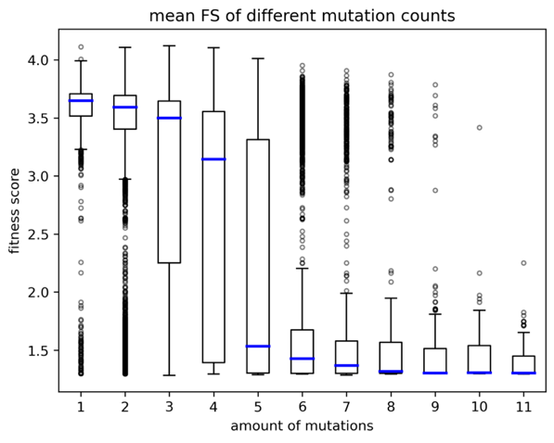
The impact of the amount of mutations
Big impact of mutation count on protein fitness
Mann - Whitney – U Test:
from seven mutations on protein is mostly non-functional
Involve in further analysis

Slide 12
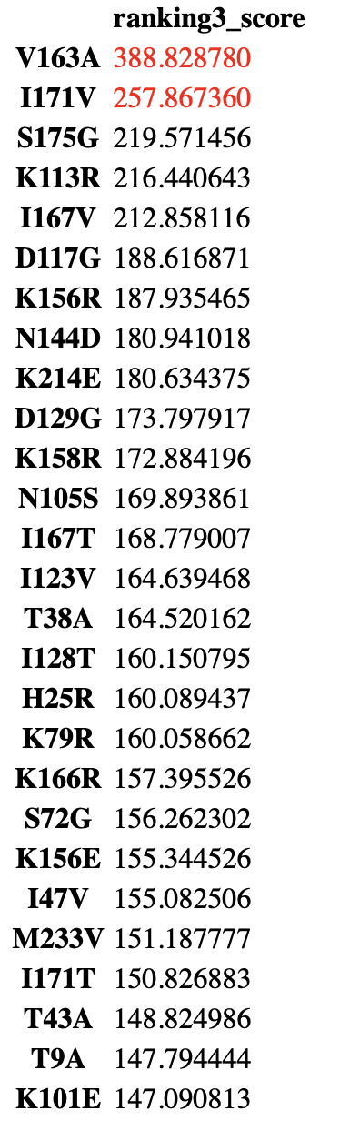
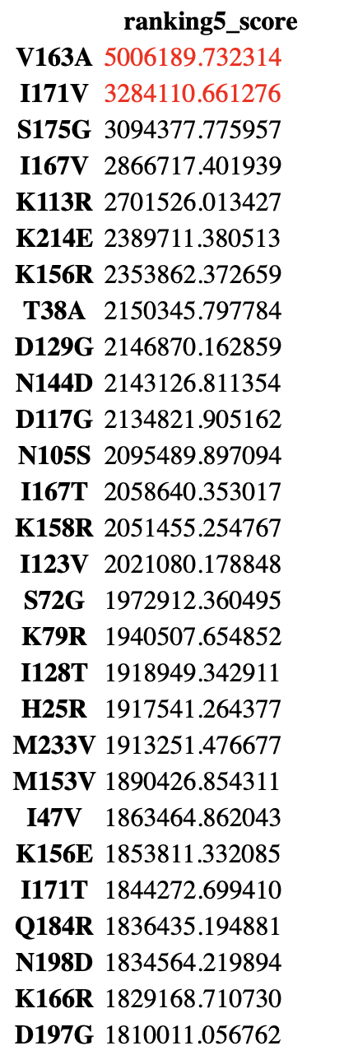
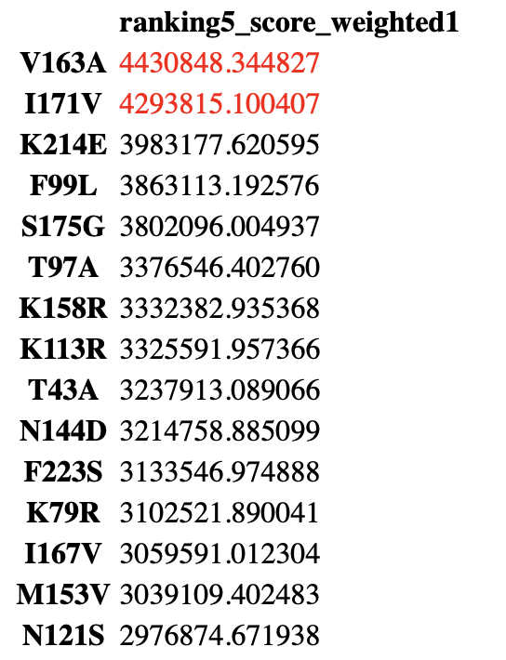
Ranking results
Formel
1
Formel 2
Formel 3

Slide 13
How to define stabilzing mutations
Wie viel besser sind die fscores der Mutanten die die Mut beinhalten im Gegensatz zu den anderen?
Differenz = mean_aller_fscores_MIT – mean_aller_fscores_OHNE
Wenn stabilsierend (positiver Effekt) → MIT > OHNE → Differenz > 0
2. Sehr unterschiedlich wie oft eine Mut im Datenset vorkommt
→ Einbeziehen (Anzahl der Vorkommnisse einer Mut im Datenset

Slide 14
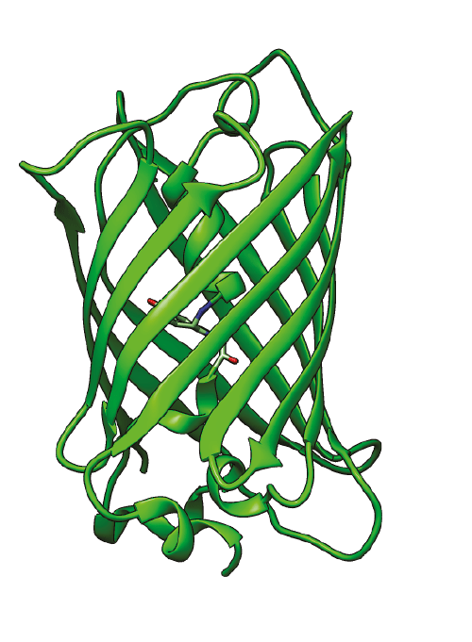

Protein Stability
Thermodynamic stability
Involves the Resistance of a folded protein conformation to denaturation
Change in Gibbs Free Energy (ΔG) going from the folded to unfolded state
Denaturation
Prediciton with Pyrosetta

Slide 15
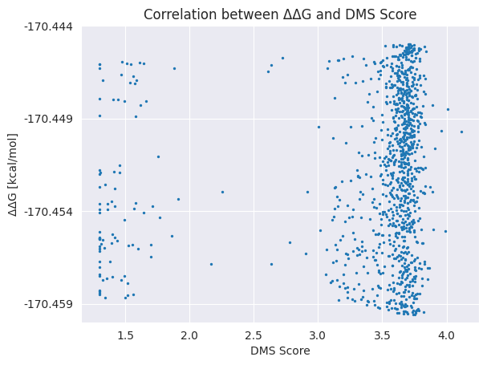
Relationship between ΔΔG and DMS Score
PyRosetta used as Prediciton Model
ΔΔG = Difference between ΔG of the WT and Mutants
No correlation between ΔΔG and DMS Score
CONCLUSION:
Experimental verification
Larger Datasets for Prediction Models (i.a. multiple mutations)

Slide 16
Thanks for listening!

